Slide 1

Trabalho de Fundamentos de Business intelligence antonio/maria Theodora/mariana

Slide 2

AGENDA
INTRODUCTION
SOLUTION OVERVIEW
Installation and Preparation Steps
Transactional database model big picture
Multidimensional database model
description of the Databases creation and preparation scripts & used mock tools
Business requirements
Business intelligence reports
fINAL TIPS & TAKEAWAYS

Slide 3

SOLUTION OVERVIEW

Slide 4





LEVERAGING THE TOOLS COVERED AT OUR BUSINESS INTELLIGENCE cOURSE
Mavenir is engaged in multiple fronts and partner collaborations when it comes to spearheading the 5G Tech Innovation.
These include areas in advanced Edge, ML/AI, SmartNIC & Private Network (NPN) driven use cases.
SQL Power Architect
Enabling Advanced Technology
Used to create the transactional and multidimensional databases.
Used as the object-relational database management system of our e-commerce project.
Used as the ETL tool to develop dw database load scripts
Used to generate mock data for transactional database, in conjunction with group’s develop Python code.
Used to generate business intelligence reports.

Slide 5
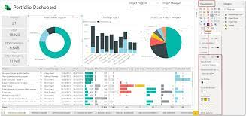
Steps toward our E-commerce business intelligence
Transactional database model
Populated st_ecommerce stage database
business requirements analysis
Multidimensional dw_ecommerce
Business Intelligence Reports

Slide 6
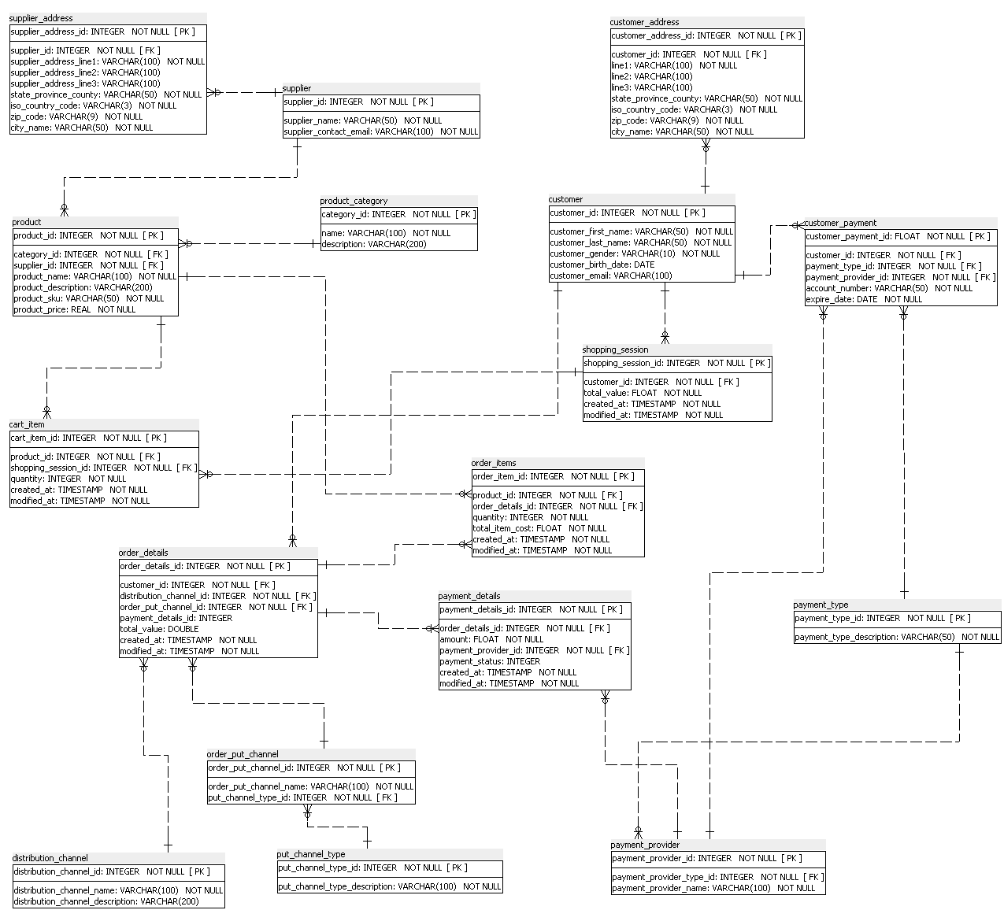
Transactional (and stage) database model

Slide 7
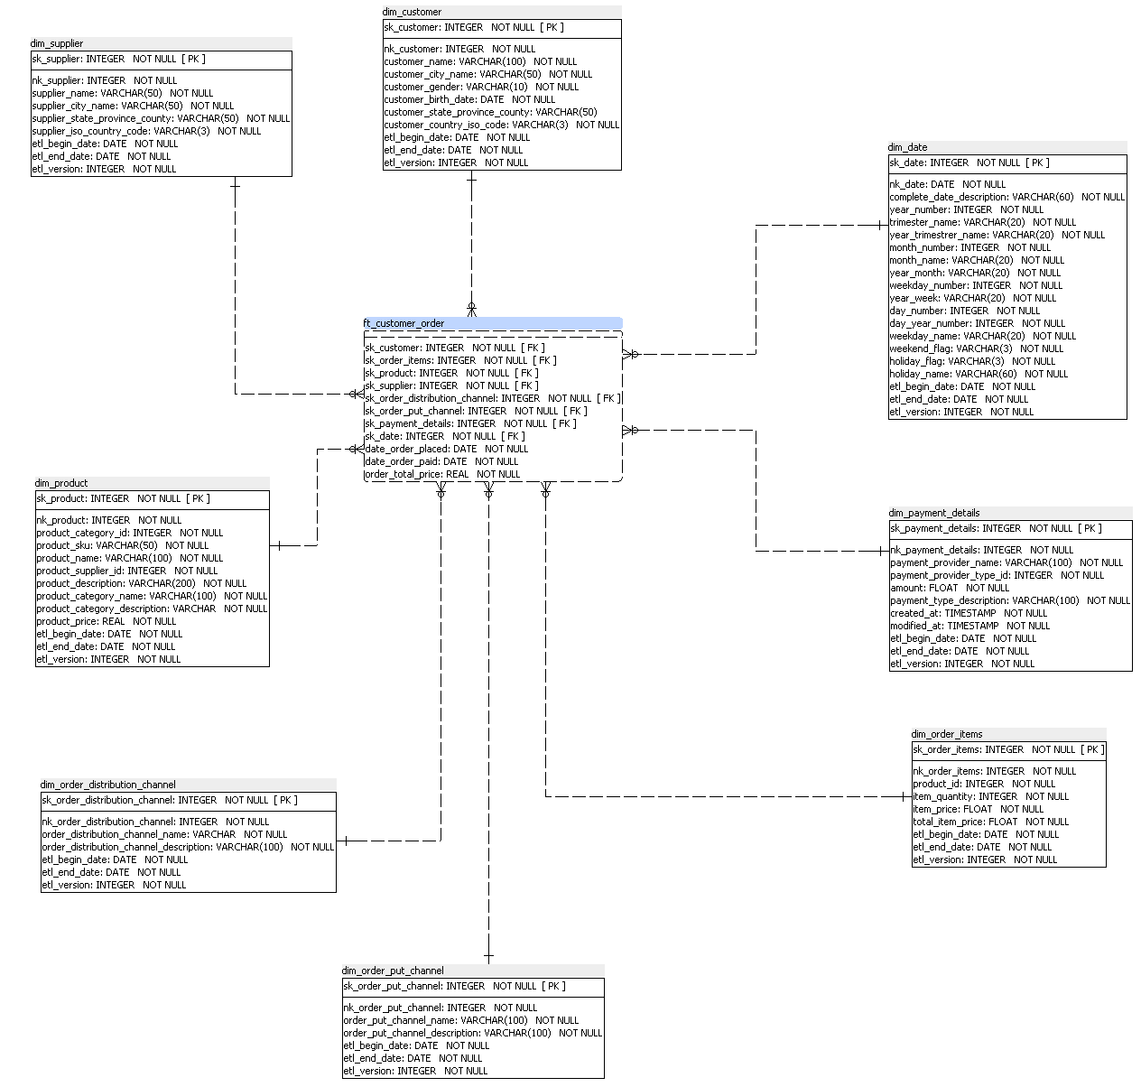
multidimensional database model
Customer dimension
Supplier dimension
Date dimension
Product dimension
Payment details dimension
Customer Order Fact
Distribution channel dimension
Order Items dimension
Put channel dimension

Slide 8
Installation and Preparation Steps

Slide 9
Steps to Create ST and DW Databases
Please firstly unzip the file trabalho-final-bi.zip to a folder on your computer
Step 1: Posgres - Creating Databases
Install (if needed) Postgres in your local machine
Create a Postgres database named st_ecommerce
Create a Postgres database named dw_ecommerce
Step 2: SQL Power Archictet (1)
Create database connection st-ecommerce pointing to the Postgres st_ecommerce database created in Step 1
Create database connection dw_ecommerce pointing to postgres database dw_ecommerce created in Step 1
Step 3: SQL Power Archictet (2)
Open file \TrabalhoFinal\power architect models\TransacionalModel.architect
Run SQL creation tool towards the database st_ecommerce
Open file \TrabalhoFinal\power architect models\MultidimensionalModel.architect
Run SQL creation tool towards database dw_ecommerce

Slide 10
Steps to Create ST and DW Databases
Step 4: Creating the dnqs’s
Open Posgres and locate yourself inside the dw database
Open a Query Tool window load and execute the file scripts\DNQSCreation_dw_e-commerce.sql
Step 5: Populate the Date dimension
Open a Query Tool window to load and execute the script scripts\LoadDateDimension.sql
Step 6: Preparation to populate st_ecommerce database
Open file STDatabaseLoadOrder . The content of the file is meant to help you through the order to be observed when populating the database with mock data.
Open Posgres and locate yourself inside the st database
Step 3 objective is to give you an order to execute the load scripts using Postgres Query Tool.
Copyright Mavenir 2021. Proprietary and Confidential.

Slide 11
Steps to Create ST and DW Databases
Step 7: Running load scripts (1)
Open a Query Tool window and execute the following scripts:
Scripts\LoadTableCustomer.sql
Scripts\LoadTableCustomerAddress.sql
Scripts\LoadTablePaymentType.sql
Scripts\LoadTablePaymentProvider.sql
Step 8: Running load scripts (2)
Open a Query Tool window and execute the following scripts:
Scripts\LoadTableCustomerPayment.sql
Scripts\LoadTablePutChannelType.sql
Scripts\LoadTablePutChannel.sql
Scripts\LoadTableDistributionChannel.sql
Step 9: Running load scripts (3)
Open a Query Tool window and execute the following scripts:
Scripts\LoadTableSupplier.sql
Scripts\LoadTableProductCategory.sql
Scripts\LoadTableProduct.sql
Scripts\LoadTableShoppingSession.sql
Copyright Mavenir 2021. Proprietary and Confidential.

Slide 12
Steps to Create ST and DW Databases
Step 10: Running load scripts (4)
Open a Query Tool window and execute the following scripts:
Scripts\LoadTableCartItem.sql
Scripts\LoadTableOrderDetails.sql
Scripts\LoadTableOrderItems.sql
Scripts\LoadTablePaymentProvider.sql
Scripts\LoadTablePaymentDetails.sql
Copyright Mavenir 2021. Proprietary and Confidential.

Slide 13
ETL Steps to Populate DW database
At the completion of step 3 you should have the databases st-ecommerce and dw-ecommerce created at your local Postgres server instance
Step 1: Creating Pentaho database connections
Open Pentaho ETL
Create a shared database connection named dw_ecommerce pointing to Posgres dw_ecommerce database
Create a shared database connection named st_ecommerce pointing to Posgres st_ecommerce database
Step 2: Pentaho(1)
Open file Pentaho-etl\version2\JOB_load_ecommerce_version2.kjb
Step 3: Pentaho (2)
Execute the job.
Upon its end you should have the dimensions and fact table ready to perform BI reports steps.

Slide 14
ETL quantitative figures
At the completion of the ETL job you will have:
Customer dimension: 2001 records
Supplier dimension: 1001 records
Date dimension: 5480 records
Product dimension: 1001 records
Payment details dimension: 4998 records
Customer Order Fact: 4998 records
Distribution channel dimension: 38 records
Order Items dimension: 5000 records
Put channel dimension: 66 records

Slide 15
Transactional database big picture

Slide 16
Multidimensional database model

Slide 17
description of the Database creation and preparation scripts & used mock tools

Slide 18
Business requirements

Slide 19
Business intelligence reports

Slide 20
fINAL TIPS & TAKEAWAYS

Slide 21

THANK YOU
Antonio Tostes
Maria Theodora
Mariana

